Slide 1
Instruct-CLIP (I-CLIP)
Improving Instruction-Guided Image Editing with Automated Data Refinement Using Contrastive Learning
刘沛雨 张家轩

Slide 2
Outline
Introduction
Motivation
Methods
Results
Improvements
TODO

Slide 3
Outline
Introduction
Motivation
Methods
Results
Improvements
TODO

Slide 4
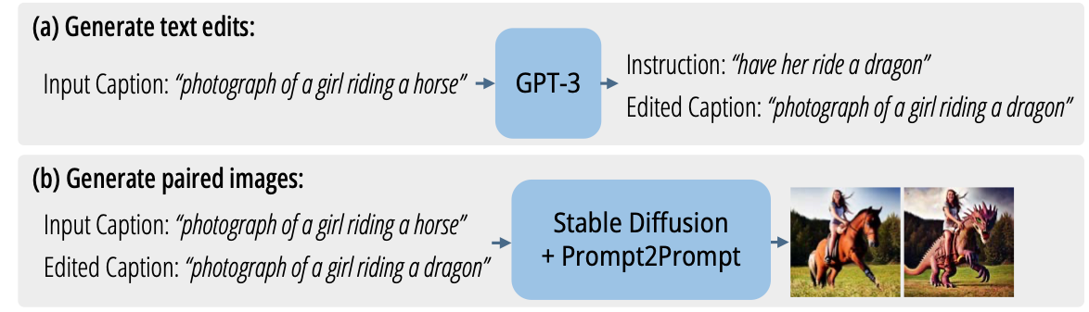


Motivation
DL-based, instruction-guided image editing needs large-scale, high-quality datasets.
Generating paired data: (original image, instruction, edited image).
Finetune LLMs to generate edited captions
(original caption, instruction, edited caption)
SD
original caption original image
edited caption edited image
(original image, edited image)
SD, P2P
Brooks et al., InstructPix2Pix: Learning to follow image editing instructions. CVPR, 2023.
Problem: instruction never sees and interacts with original image and edited image directly.
“make it a daydream”

Slide 5
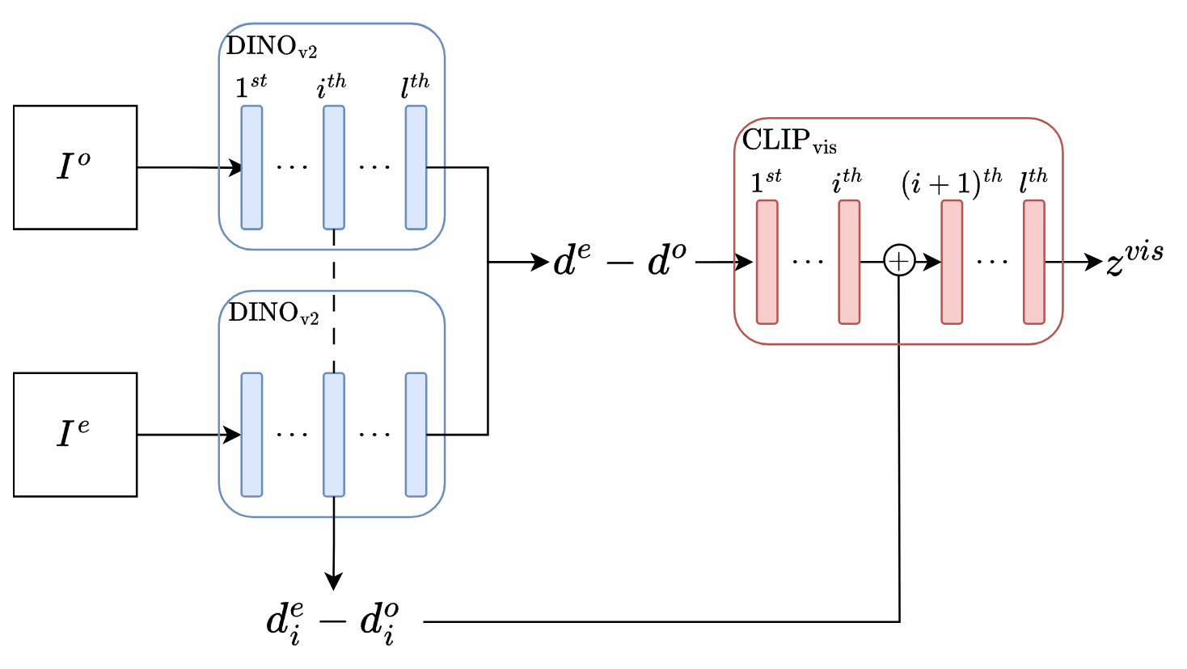
Instruction refinement
Refine instruction after seeing differences between original image and edited image.
original image
differences
encoded differences
edited image
I-CLIP_{vis}: visual difference encoder

Slide 6
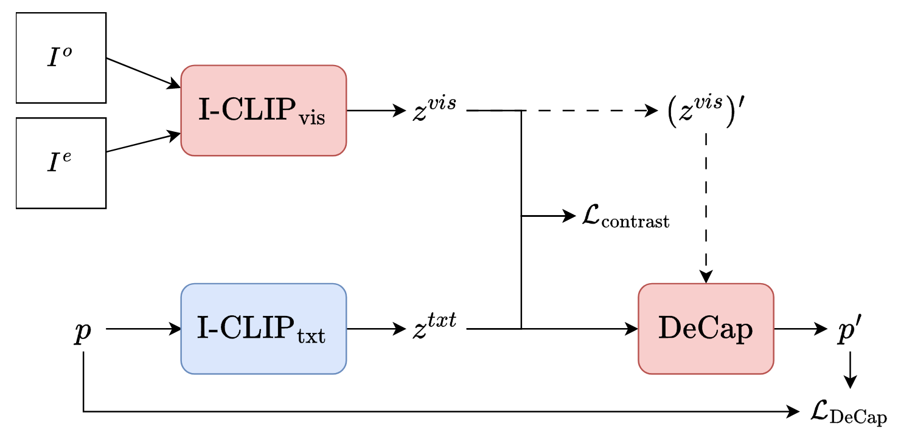
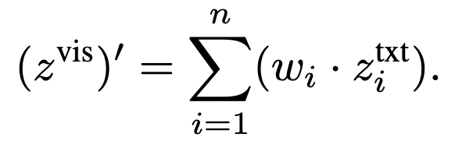
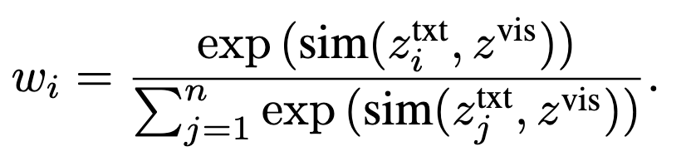

Instruction refinement
instruction should describe differences between original image and edited image.
encoded differences
original image
edited image
Dress $z^{vis}$ up as a text encoding during inference.
instruction
refined instruction
I-CLIP architecture
Inference: replace instruction with refined instruction if the latter is better.

Slide 7
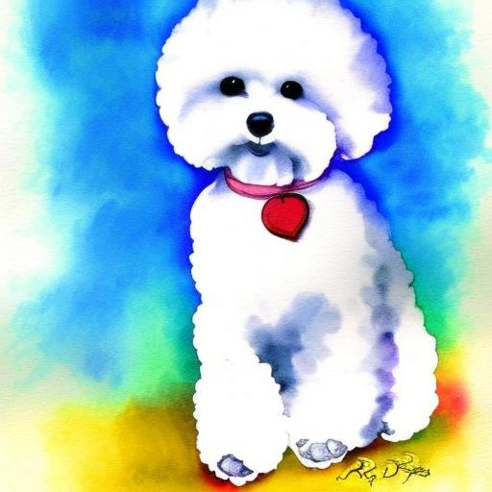
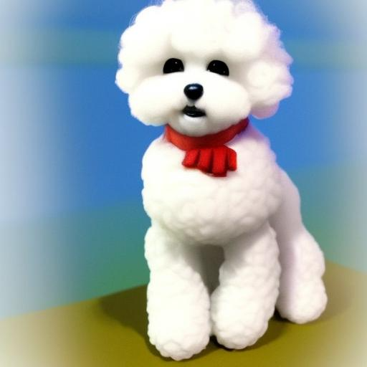


Instruction refinement
original image
edited image
instruction
refined instruction
Paper: “as a 3 d sculpture”
“make it a video game character”
Reproduced: “as a 3 d computer model”
Paper: “make it spring”
“make it a daydream”
Reproduced: “make it a summer day”

Slide 8
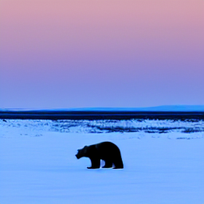
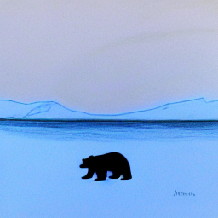
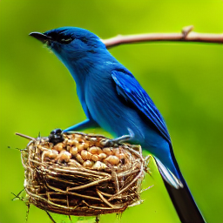
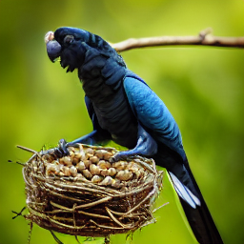
Instruction refinement
original image
edited image
instruction
refined instruction (reproduced)
“make it a drawing”
“make it into a watercolor painting”
“make the bird a cockatoo”
“replace the bird with a hummingbird”

Slide 9
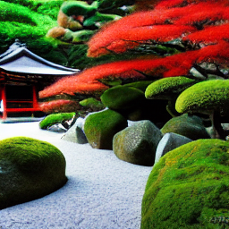
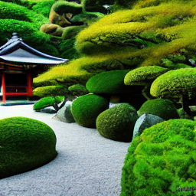
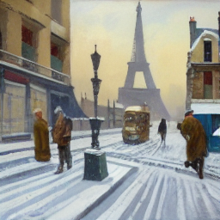
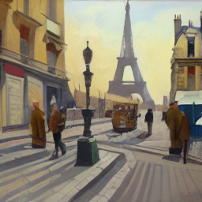
Instruction refinement
original image
edited image
instruction
refined instruction (reproduced)
“add a hedge maze”
“the leaves yellow leaves”
“make it a sunny day”
“make it a sunny day”

Slide 10
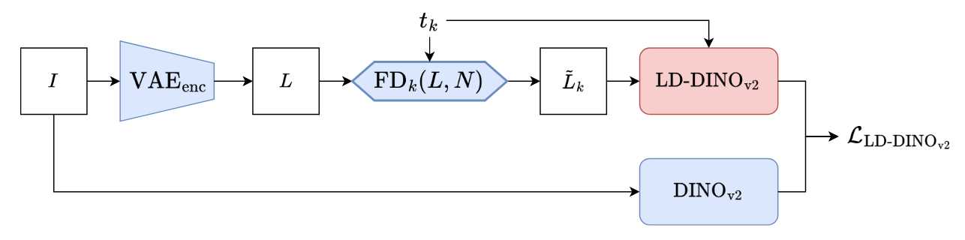

I-CLIP as a judge
$ℒ_{I−CLIP}=1−sim(z^{vis},z^{txt})$
is used when finetuning SD-based image editing models.
judges whether the differences between original images and
generated edited images match instruction.
However, SD works in latent space while DINO works on raw images.
Distillation: DINOv2 $→$ LD-DINOv2.
Replace DINOv2 in I-CLIP_{vis} with LD-DINOv2.
In this way, I-CLIP can extracting $z^{vis}$ from SD outputs (in latent space) with LD-DINOv2, without decoding SD outputs into generated images
replace

Slide 11
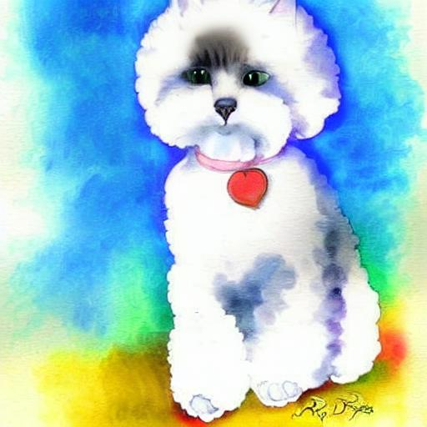
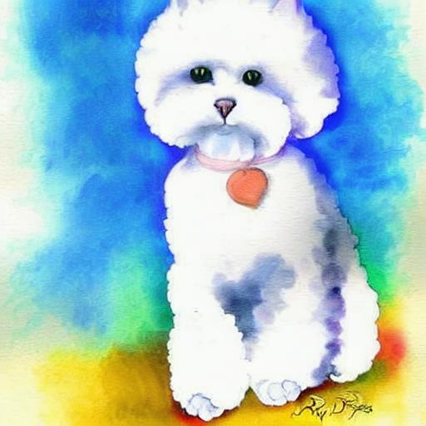
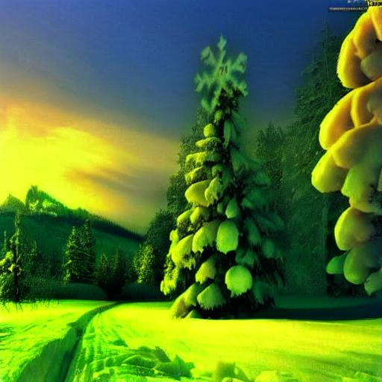
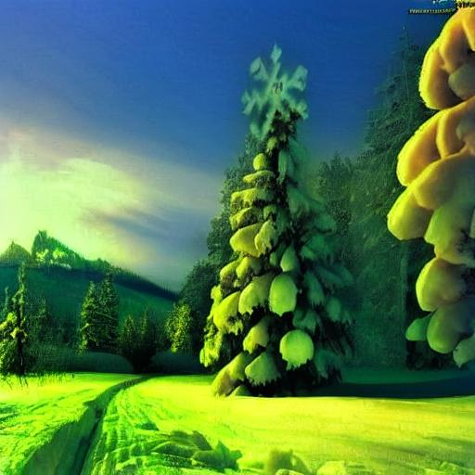
I-CLIP as a judge
edited image
original image
instruction
paper
reproduced
“make it a cat”
“remove snow”

Slide 12
Reference
Chen et al., Instruct-CLIP: improving instruction-guided image editing with automated data refinement using contrastive learning. CVPR, 2025.
Brooks et al., InstructPix2Pix: learning to follow image editing instructions. CVPR, 2023.

Slide 13

Thank you!

